Slide 1
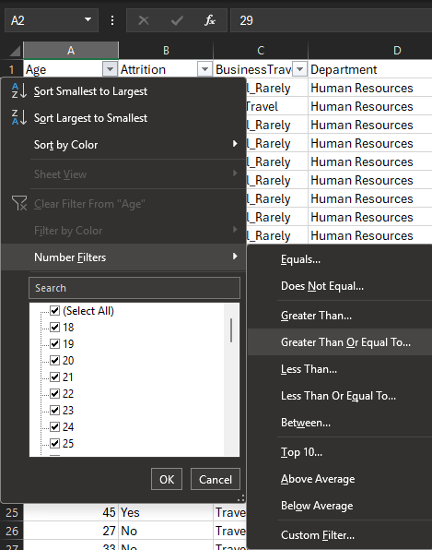
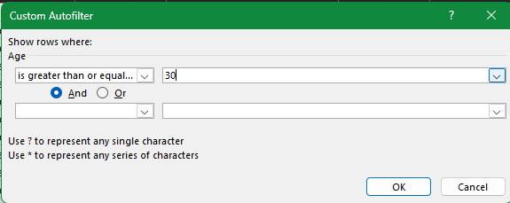
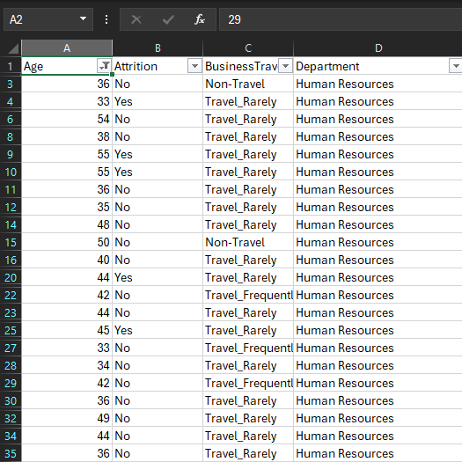
1. Using Excel, how would you filter the dataset to only show employees aged 30 and above?

Slide 2
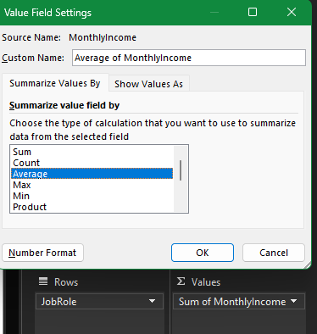
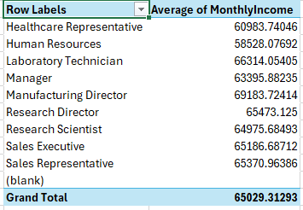
2. Create a pivot table to summarize the average Monthly Income by Job Role.

Slide 3
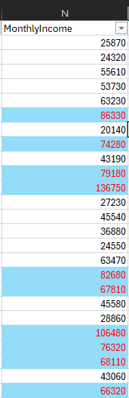
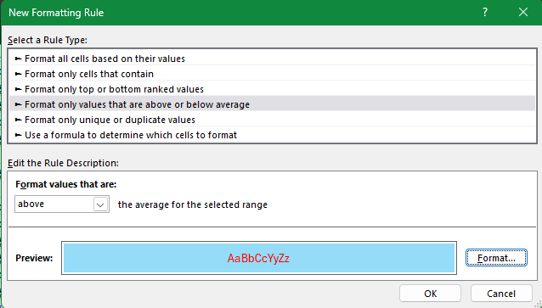
3. Apply conditional formatting to highlight employees with Monthly Income above the company's average income.

Slide 4
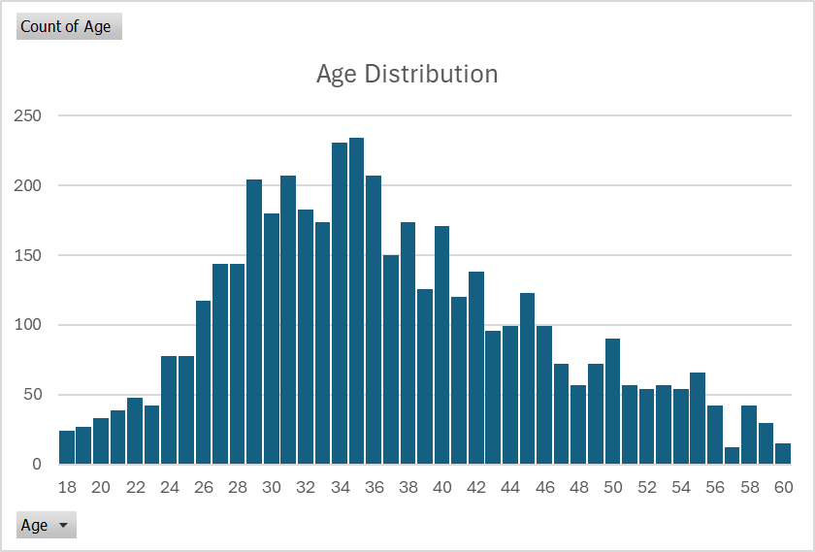
4. Create a bar chart in Excel to visualize the distribution of employee ages

Slide 5
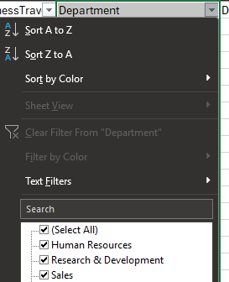
There are No missing values or inconsistent data in the Department column.
5. Identify and clean any missing or inconsistent data in the "Department" column.

Slide 6
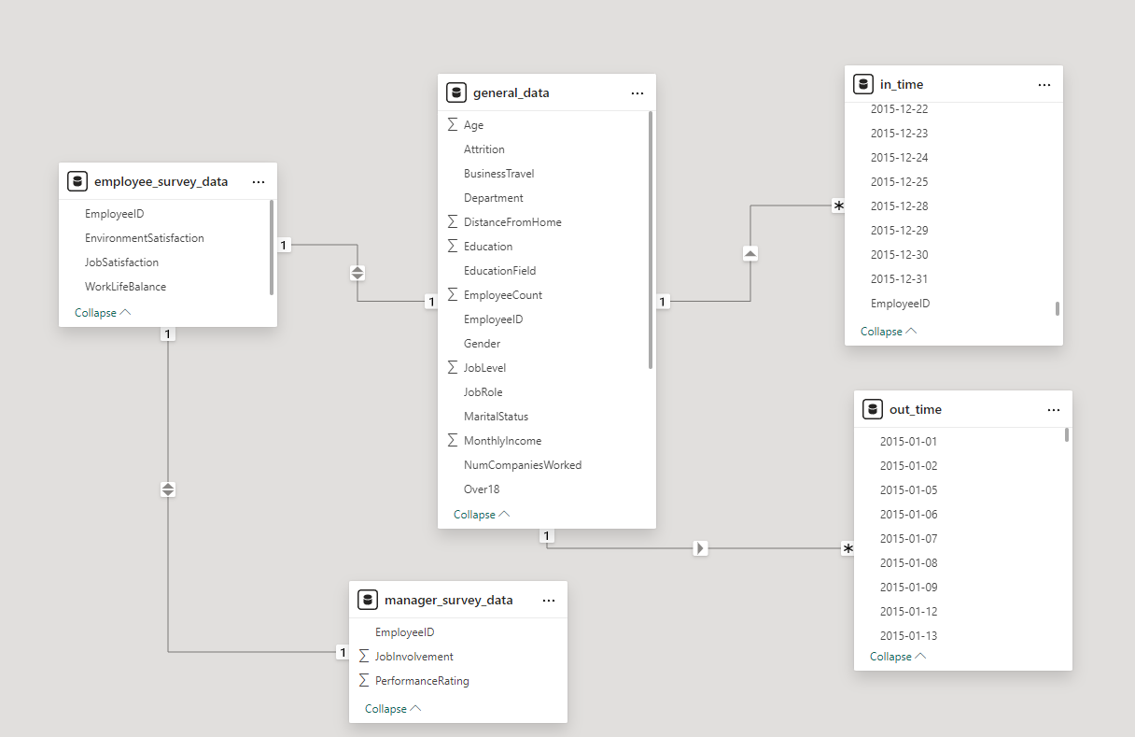
In Power BI, establish a relationship between the "EmployeeID" in the employee data and the "EmployeeID" in the time tracking data.

Slide 7
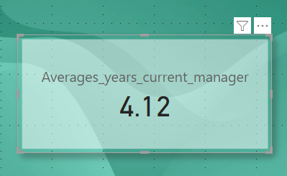
7. Using DAX, create a calculated column that calculates the average years an employee has spent with their current manager.

Slide 8
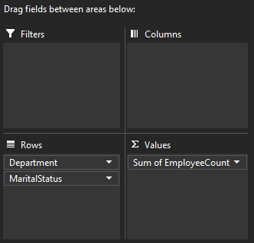
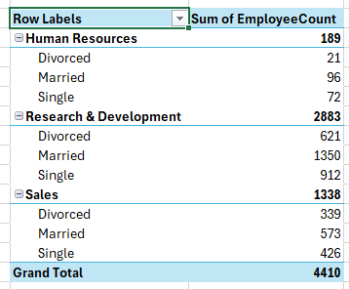
Using Excel, create a pivot table that displays the count of employees in each Marital Status category, segmented by Department.

Slide 9
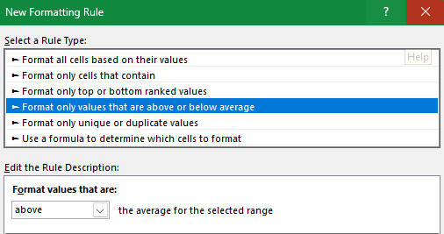
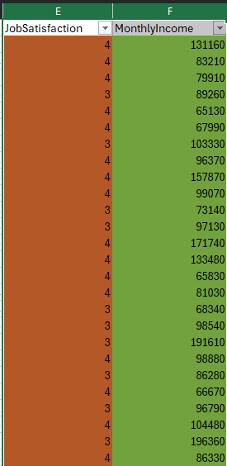
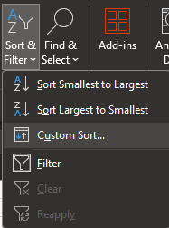
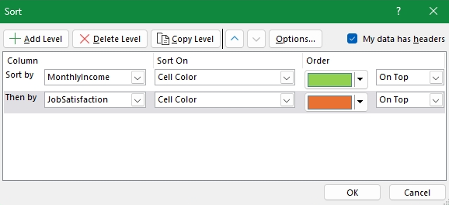
9. Apply conditional formatting to highlight employees with both above-average Monthly Income and above-average Job Satisfaction.

Slide 10
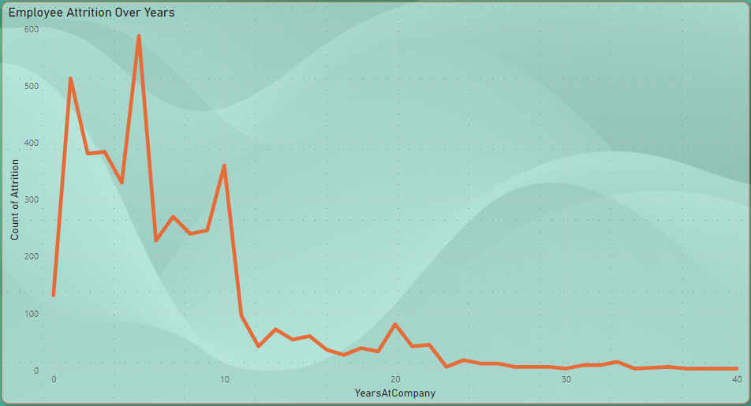
10.In Power BI, create a line chart that visualizes the trend of Employee Attrition over the years.

Slide 11

11. Describe how you would create a star schema for this dataset, explaining the benefits of doing so.
Steps to Create star schema for this dataset:
Import all the tables
Load all the table.
Go to the Model view section
Take General_data as central query.
Establish relationship with employee_survey_data, in_time, out_time,manager_survey.
Benefits :
Simple and easy-to understand structure
Better Performance for analytical queries
Fewer joins to access data

Slide 12
12. Using DAX, calculate the rolling 3-month average of Monthly Income for each employee.
Rolling 3-Month Average =
CALCULATE(
AVERAGE(general_data'[Monthly Income]),
DATESINPERIOD(
‘general_data'[Date],
LASTDATE(‘general_data'[Date]),
-3,
MONTH ) )

Slide 13
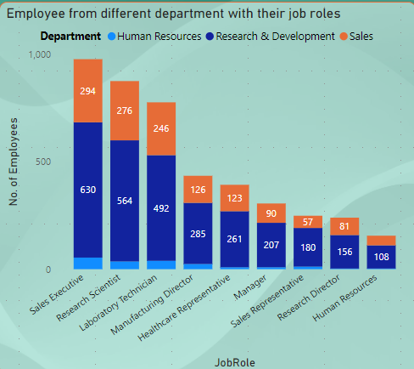
13. Create a hierarchy in Power BI that allows users to drill down from Department to Job Role to further narrow their analysis.

Slide 14
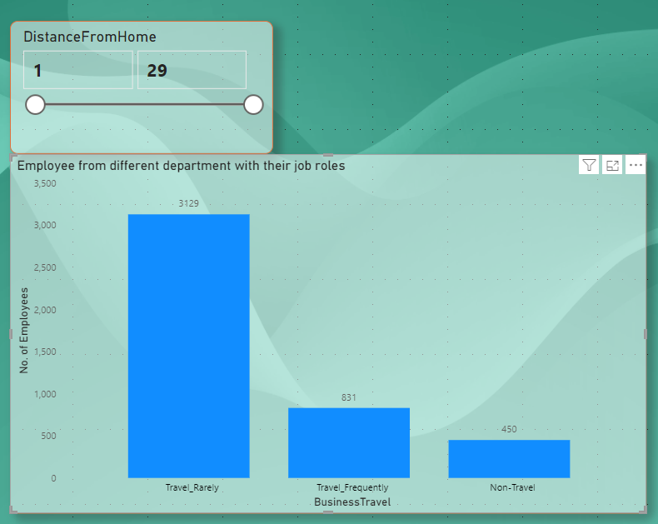
14. How can you set up parameterized queries in Power BI to allow users to filter data based on the Distance from Home column?

Slide 15
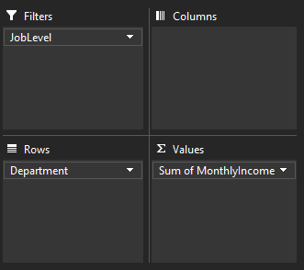
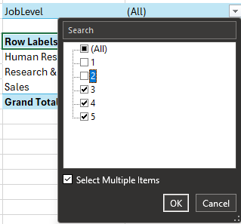
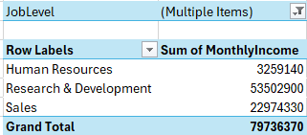
15. In Excel, calculate the total Monthly Income for each Department, considering only the employees with a Job Level greater than or equal to 3.

Slide 16

16. Explain how to perform a What-If analysis in Excel to understand the impact of a 10% increase in Percent Salary Hike on Monthly Income

Slide 17
To verify if the data adheres to a predefined schema we need to first understand the business rules to make sure that our relations, tables, columns and data types are the correct ones.
In the case I find inconsistencies, I would correct some of them manually, and others using a software process to clean my data , communicate my findings with the interested parts and actualize the schema if necessary.
17. Verify if the data adheres to a predefined schema. What actions would you take if you find inconsistencies?

